Slide 1
Fraud Awareness & Detection in Today’s Times
Michael Boeheim, CIA, CFE
Director
Robert Wood, CPA
Senior Manager

Slide 2
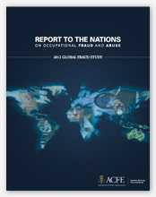
Statistics
Report to The Nations
On Occupational Fraud and Abuse
2012 Global Fraud Study

Slide 3

ACFE
Association of Certified Fraud Examiners
    Freed Maxick ABL Services, LLC
    ACFE

Slide 4
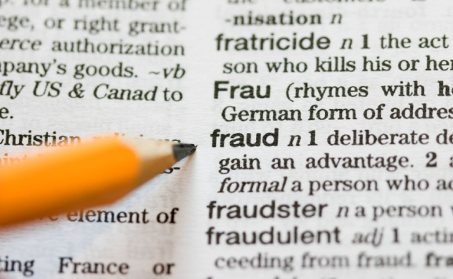
Definition Of Fraud
Intentional misrepresentation of truth in order to induce another to part with something of value
Notes:
Help me

Slide 5
Fraud Triangle
Opportunity
  Pressure (Motive)
Rationalization

Slide 6
Most Common Fraud Schemes

Slide 7
Occupational Fraud
Asset Misappropriation – misuse of a company asset for personal gain
Corruption – the wrongful use of influence to procure a benefit for the perpetrator or another person, contrary to the duty or the rights of others.
Financial Statement Fraud – the deliberate misrepresentation of the financial condition of a company through intentional misstatement or omission of amounts or disclosures in the financial statements to deceive the financial statement users.

Slide 8
Association of Certified Fraud Examiners
In a recent survey involving 3,000 executives of businesses large and small in 54 countries found that 88 percent of U.S. companies reporting some type of fraud also reported declines in financial performances. In addition, three-fourths of the crimes against businesses in the U.S. were carried out by insiders.

Slide 9
Statistics
According to the ACFE 2012 Global Fraud Study: Report to the Nations on Occupational Fraud and Abuse (1,388 cases)
Survey participants estimated that the typical organization loses 5% of its revenue to fraud each year
The median loss caused by the occupational fraud cases in the study was $140,000
In the study, the frauds that were reported lasted a median of 18 months before being detected
Occupational fraud is more likely to be detected by a tip than by any other method (43.3% in 2012)
In 81% of the cases reported, the perpetrator displayed one or more behavioral red flags.

Slide 10
Management Fraud Pressures
Negative cash flow being sustained by the business
Personal abuse problems…gambling, alcohol, drugs, etc.
An unwillingness to make changes in lifestyle
A very strong ego that will not allow the company to go down, at any cost

Slide 11
Management Motives
Executives that are involved extensively in gambling or speculative transactions
Executives with questionable backgrounds (background checks)
Executives whose financial success is completely tied to the success of their company
Executives with high personal debt or financial needs

Slide 12
Opportunities For Management Fraud
An institution that lends money but does not monitor financial performance carefully
An institution that does not monitor collateral carefully
An institution that does not respond to audit findings

Slide 13

Rationalizations
“It’s O.K., I’m not going to hurt anyone.”
“It’s O.K., everyone else does it.”
“I will only borrow for a while, then pay it back.”
“The financial institution can afford to take the risks, look at all the collateral they have.”

Slide 14
KPMG Integrity Survey
74% of employees have personally observed or have firsthand knowledge of wrong doing within their organization.
46% of employees reported that what they observed could cause a significant loss of public trust if discovered.

Slide 15

Management Fraud Symptoms
(Red Flags)
Operating performance anomalies
Management characteristics that indicate possible motives
Organizational structure anomalies
Irregularities in relationships with outside parties
Irregularities in source documents
Management/staff turnover

Slide 16
Operating Performance Anomalies
Unexplained changes in financial statement or borrowing base balances
Operating on a crisis basis
Urgent need to report favorable earnings
Unusual or large and profitable transactions near the end of accounting periods

Slide 17
Operating Performance Anomalies
Deteriorating earnings
Insufficient capital
Difficulty in collecting receivables
Expenses increasing faster than revenues
Dependence on a concentration of customers or vendors
Significant litigation

Slide 18
Management Characteristics
Extravagant Lifestyle
All questions must go through one person
No separation of duties
Belligerent
Appears stressed/nervous
Threats/Bribes

Slide 19
Organizational Structure Anomalies
Unduly complex business structure (numerous cash accounts)
Severe obsolescence of assets
Changes in Executives or Directors
Significant transactions by related parties

Slide 20
Irregularities With Outside Parties
Frequent changes in auditors
Problems with regulators
Frequent changes in outside legal counsel
Use of several different financial institutions

Slide 21
Irregularities In Source Documents
Missing documents
Stale items on bank reconciliations
Excessive voids or credits
Reluctance to provide auditors or financial institution with needed data
Increased reconciling items
Alterations on documents
Document sequences that don’t make sense

Slide 22
Median Loss Per Financial/Collateral Category According to the Association of Certified Fraud Examiners – Report to the Nation

Slide 23
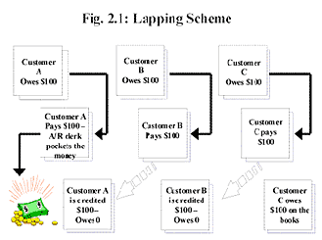
Accounts Receivable Schemes
  Lapping
  Fictitious sales/customers
  Diversion of payments

Slide 24
A/R Collateral Procedures
Reconciliations
  Reconcile from Aging to the Financial Statements and Loan Ledger Reports and the Borrowing Base Report
Ship Test
  Shipping support (fraudulent BOLs, Pro Numbers)
  Purchase orders (third party verification)
  Watch for unusual transactions (end of month)
  Be true to your sample
Credit Memo Analysis
  When commonly issued (over 90 days, BOM)
  Supporting Documentation

Slide 25
A/R Collateral Procedures
Trend Analysis
  Increase in turnover (less cash receipts, extending terms)
  Increase in dilution (false invoices, defective goods in inventory)
  Increase in invoices over 90 days
New Customer Analysis
  Compare customer listing to prior month; Investigate all new customers
Phone Verifications
  Do confirms give accurate results?
  The “bouncing phone”

Slide 26

Inventory Schemes
  Vendor inventory
  Customer inventory
  What’s in the box?
  Disorganized inventory
  Incomplete goods
  Costing methods
  Lack of appropriate information
  Perpetual records
  Shipping documents

Slide 27
Inventory Collateral Procedures
Reconciliations
  Unusual reconciling items
  Reconcile from the agings to the financial statements and loan ledger reports and the Borrowing Base Report
General Ledger Detail Review
  Journal entries to increase inventory valuation
  End of month activity
Cost Testing
  Types of cost inclusions (Sec 263A, Non-manufacturing costs)
  Reasonableness of overhead rates (non-Material costs too high)

Slide 28
Inventory Collateral Procedures
Gross Profit Testing
  Test margins less than financial statements (when should you become alarmed?)
Test Counts
  Performing the counts (move pallets, open boxes)
  Selecting the items (New Items since prior exam)
Slow Moving Analysis
  Selecting the criteria appropriate for the industry and company (review dates on vendor invoices). What information can company provide?

Slide 29
Inventory Collateral Procedures
Analytical Review
  Review/Investigate significant changes in gross margins from month to month.
  Review/Investigate inventory components (raw material, work in process and finished goods) or specific inventory items as a percentage of total inventory from month to month.
  Inventory Turnover (sales or cost of sales in relation to inventory). The increase in turnover days may indicate slow moving or inflated inventory values.

Slide 30
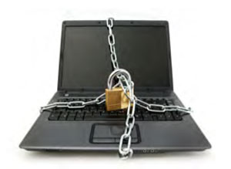
Deterrent to Inventory Fraud
Proper Documentation
- Control of pre-numbered internal forms
Segregation of Duties
- Requisition/Receipt/Disbursement
Independent Counts
Physical Safeguards

Slide 31

Accounts Payable Schemes
  Hiding vendor invoices
  Fictitious/Affiliated Vendors
  Unrecorded liabilities
  Deferred revenue
  Customer deposits

Slide 32
Accounts Payable Procedures
Review Accrual Accounts
Review/Age Outstanding Checks
Review Vendor List for unusual items
Understand Relationship with Major Vendors
Trade Surveys
Analyze/Compare Purchases and Inventory levels

Slide 33
Financial Statement Fraud
Fraudulent Financial Reporting
- Alteration of Records
- Omission of significant information
- Misapplication of accounting principles
Misappropriation of Assets
“Financial statement fraud is the most costly for of occupational fraud, causing a median loss of $1 million”
ACFE

Slide 34

Financial Statement Fraud Detection
Vertical Analysis
Horizontal Analysis
Ratio Analysis

Slide 35
Deterrent to Financial Statement Fraud
83% of Financial Statement frauds involved the CFO or CEO who may override internal controls.
Therefore,
Reduce pressures – unachievable goals, align variable compensation with long term company goals.
Reduce Opportunity – physical security system
Reduce Rationalization – Fraud and Ethics policies

Slide 36
General Ledger Review Procedures
General Ledger
  Review of activity and how entries are posted to given accounts
  What is the second side of entries in question
  Month end postings
  Analytic review

Slide 37
The Five Step Approach
To Fraud Detection
Know the exposures
Know the symptoms of occurrence
Be alert for symptoms
Build audit procedures to look for symptoms
Follow through on all symptoms observed
“Frauds are much more likely to be detected by tips than any other method.”
ACFE

Slide 38
Fraud Prevention
Strong Internal Controls (Most Effective)
Employee Education
Background Checks
Regular/Surprise Audits
Adequate Reporting Programs (hotlines)
Prosecution (Least Effective)
Proactive Fraud Policies

Slide 39

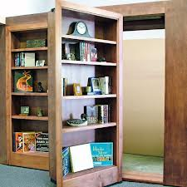
Recent Fraud Cases
“Secret Garden”

Slide 40
Summary
Fraud is here to stay
Fraud is not infrequent
Companies need to develop a fraud awareness program and provide specific training in fraud detection
Quick responses to fraud findings, when they are small
“Where there is smoke, there is fire.”

Slide 41

Questions ?
Contact info:
FREEDMAXICK.COM
Freed Maxick ABL is the brand under which Freed Maxick CPAs, P.C. provides services to its clients. Square logo, FreedMaxick, and “Trust Earned.” are trademarks of Freed Maxick CPAs, P.C.

